Slide 1

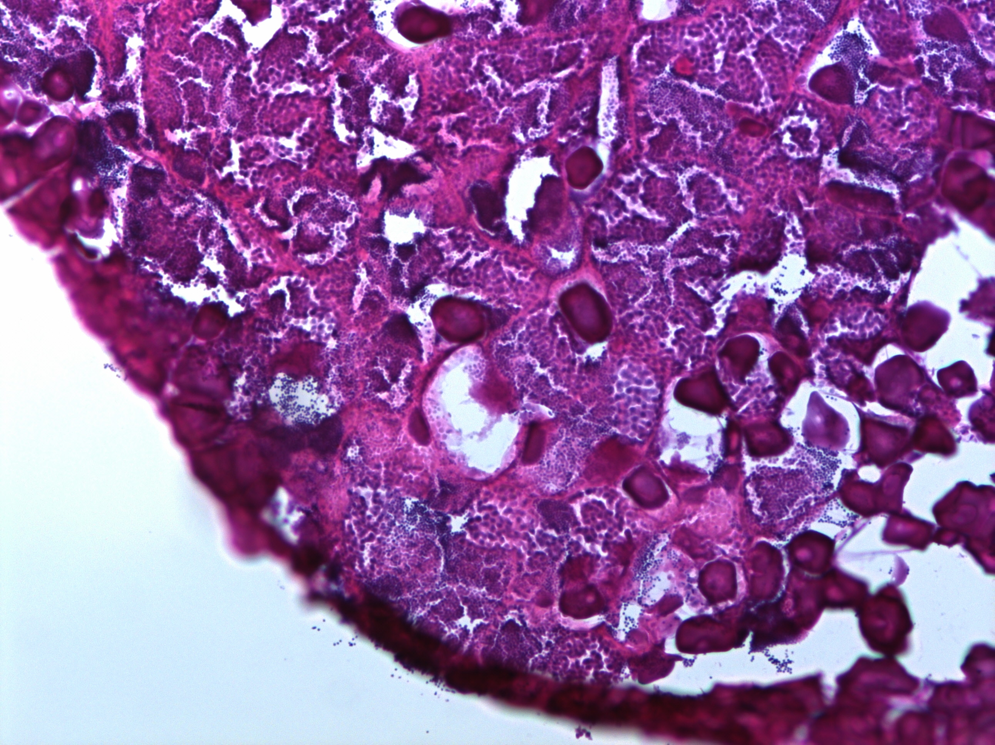
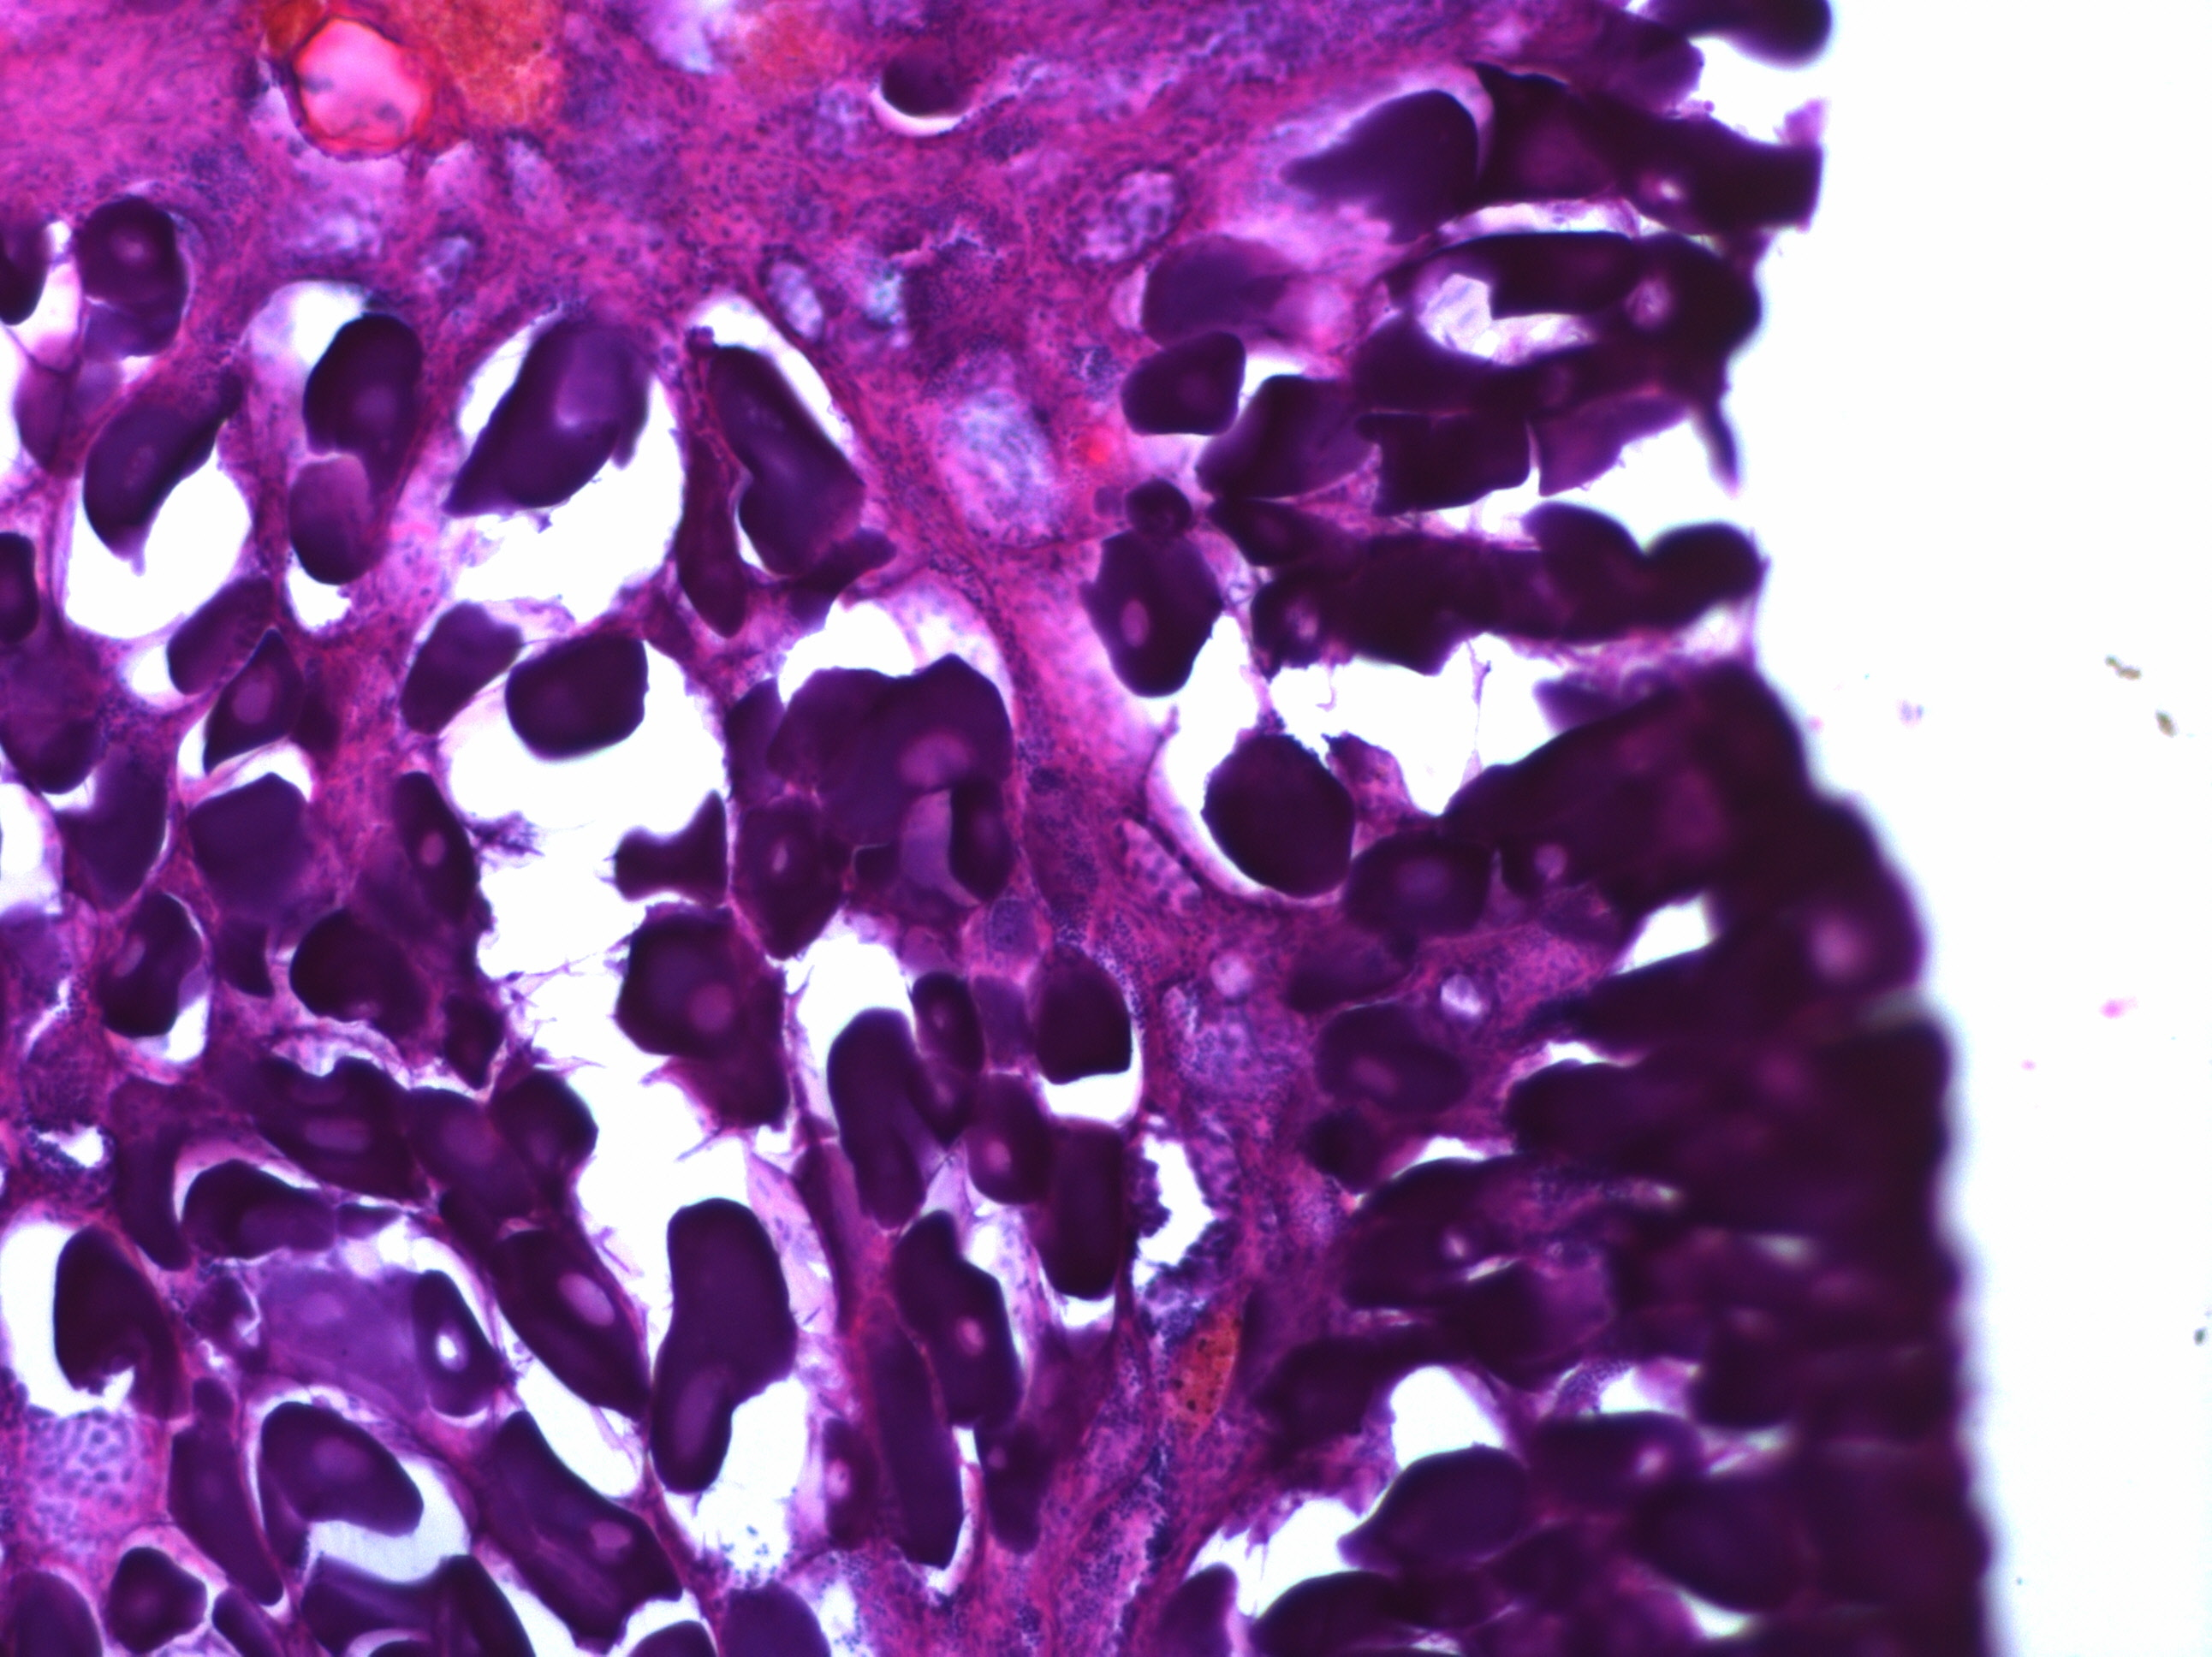
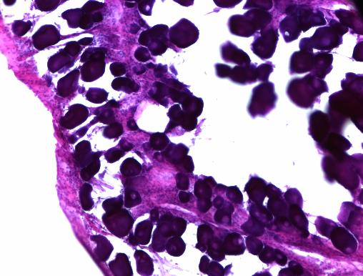
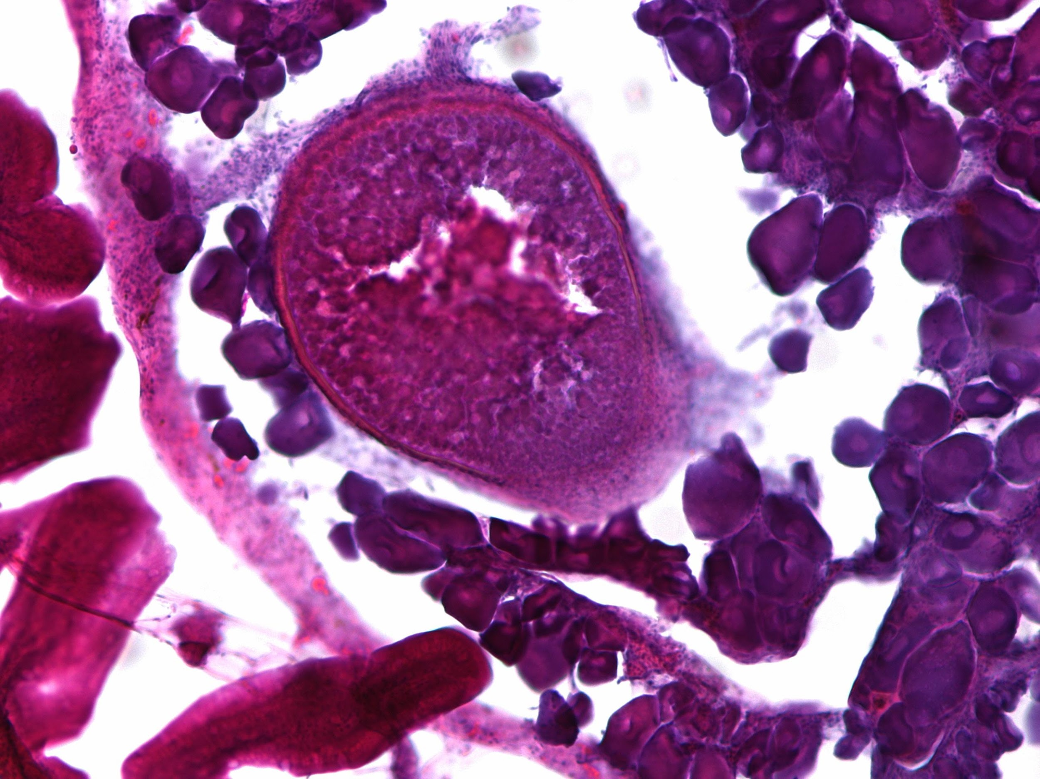
A
Parameter
Max
11KT
E2
Percent Testicular
Vitellogenesis
Body Mass
Neurogenesis
Min
Aggression
♂
I
LI
♀
Parental Care
♂
IP
LIP
♂
Sex Change Progression
B
C
D
Male
800
ab
bc
bc
a
ab
c
ab
abc
80%
d
b
ab
a
c
cd
600
60%
Testicular %
Parental Behaviors
40%
400
7.64x
Intermediate
200
2.21x
3.88x
11.08x
20%
0
0%
F
M
I
IP
LI
LIP
NF
NM
100%
M
I
IP
LI
LIP
NM
ab
c
bc
a
abc
bc
a
abc
a
c
c
b
b
ab
600
Phase
Phase
80%
400
1.69x
1.84x
Ovarian %
Time in nest (s)
2.14x
60%
Late Intermediate
200
10.67x
40%
0
F
M
I
IP
LI
LIP
NF
NM
20%
3.5
a
d
cd
bc
a
bcd
ab
bcd
c
ab
a
c
abc
bc
Phase
0.3
Phase
3.0
Female
2.5
1.11x
0.0
Corrected log₁₀ volume (px)
Log10 11KT (pg/ml)
1.85x
1.69x
1.35x
2.0
-0.3
1.5
-0.6
F
M
I
IP
LI
LIP
NF
NM
M
I
IP
LI
LIP
NM
Phase
Notes:
We need to note that the female example is from a previous publication

Slide 2
Fig.1. Male, intermediate, and female anemonefish display distinct physiology and behavior. (A) Schematic outlining the behavioral and physiological changes that occur during protandrous sex change in anemonefish.
(B) Top panel: Parental behaviors observed during a parental care assay. Middle panel: Time spent in the nest during parental care assay; a proxy for parental care. Bottom Panel: Log10 transformed serum 11-ketotestosterone.
(C)Top panel: Percent of the gonad made of testicular tissue. Middle panel: Percent of the gonad made of ovarian tissue. Bottom panel: Gonadal volume corrected for the individual’s length (methods).
(D) Example hematoxylin and eosin stains of gonads from the major phases of sex change.
In B, plots are subdivided such that the dominant and subordinate individuals from each pair appear together reflected by shape and color.Arrows indicate fold-difference between the two groups. In B, C, crossbar indicates mean, error bars indicate standard error of the mean (SEM). Letters indicate significance: groups that do not share a letter are significantly different.

Slide 3
A
13
B
11
12
26
4
1
15
17
25
7
22
3
9
24
2
6
0
18
8
21
5
UMAP_2
14
19
20
16
UMAP_1
10
23
C
Scaled Proportion of Region
Multiome Cluster
D
Multiome Cluster

Slide 4
Fig.2. Multiomics capture high quality transcriptomes, epigenomes, and spatial transcirptomes,
UMAP embeddings of our sn-Multiome data with each cluster numbered.
(B) Dotplot showing canonical and data-driven markers for each of our multiome clusters.
(C) Heatmap showing the scaled proportion of each neuroanatomical region made of each multiome cluster (see supplement xx for abbreviations).
(D) Example projections of multiome clusters onto representative brain sections. The dashed line indicates approximately where we dissected brains for sn-multiomics analysis. Below each section is a sketch of an A. ocellaris brain with a line indicating the approximate sectioning plane for the given section.

Slide 5
A
1_RGC
B
6_POA_Mixed
E
1.00
First Changes
Glutamatergic
p = 0.907
16%
**
0.75
GABAergic
**
***
*
Mixed
20%
12%
p = 0.510
Prediction
Glial
0.50
% of Cells
% of Neurons
10%
8%
0.25
Last Changes
4%
0.00
2_OL
5_Glut
16_Glut
11_MG
1_RGC
17_Glut
18_Glut
8_VOT_Glut
12_Glut
10_nHv_Glut
19_Di_GABA
0_Spall_Mixed
4_TGN_Glut
3_Spall_GABA
0%
M
I
LI
NF
F
0%
M
I
LI
NF
F
21_Spall_GABA
6_POA_Mixed
C
Phase
50
40
30
DEGs
20
10
Classification
0
Early Down
2_OL
5_Glut
11_MG
15_EC
26_DG
1_RGC
12_Glut
16_Glut
9_Mixed
13_OPC
17_Glut
20_Leuko
25_GABA
7_Pall_Glut
10_nH_Glut
18_Glut
22_Di_Glut
Early Up
0_Spall_Mixed
4_TGN_Glut
8_VOT_Glut
19_Di_GABA
23_NLT_GABA
3_Spall_GABA
6_POA_Mixed
14_Vsst_GABA
21_Spall_GABA
24_Vs-m_Mixed
Late Down
D
Late Up
9
Progressively Down
Progressively Up
6
Transiently Down
DARs
Transiently Up
3
0
2_OL
5_Glut
11_MG
15_EC
26_DG
1_RGC
12_Glut
16_Glut
9_Mixed
13_OPC
17_Glut
20_Leuko
23_NLT
25_GABA
7_Pall_Glut
10_nH_Glut
18_Glut
22_Di_Glut
0_Spall_Mixed
4_TGN_Glut
8_VOT_Glut
19_Di_GABA
3_SPall_GABA
6_POA_Mixed
14_Vsst_GABA
21_SPall_GABA
24_Vs-m_Mixed

Slide 6
Fig.3. Cells change composition, transcriptome, and epigenome asynchronously during sex change.
The percent of all cells belonging to 1_RGC.
(B) The percent of all neurons belonging to 6_POA_Mixed.
(C) The number of differentially expressed genes (DEGs) by multiome cluster.
(D) The number of differentially accessible regions (DARs) by multiome cluster.
(E) Machine learning predictions for the mean sex of intermediates based on their expression of DEGs and DARs by multiome cluster; a proxy for the temporal order of sex change Shape and color represents broad cell type.
In C, D, bars are colored based on our classification for the manner in which they change sex (see methods). In A, B, points indicate the proportion for each individual. Asterisks: “*”: p < 0.05, “**”: p < 0.01, “***”: p < 0.001.

Slide 7
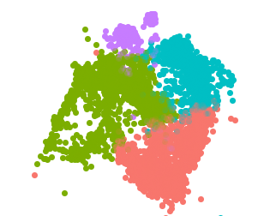
A
cyp19a1b
B
1_RGC DEGs
***
p = 0.283
3
***
M
I
F
Expression
2
†
†
†
†
†
†
§
§
1
†
†
†
sox6
gli1
rpl24
cog5
lrch4
lhfpl3
tap2t
plce1
glceb
pcnx4
foxp2
fgfbp3
dab1a
ssbp4
mical2b
kcnh6a
immp2l
skida1
tmed4
tmtc2b
nkx2.2a
slc44a2
znf710b
nlrc3-like
gjc1-like
il1rapl1a
brd3-like
sema3ab
ccdc85cb
cyp19a1b
fmnl1-like
lrrc49-like
jam3b-like
dbx1b-like
pp1r37-like
zgc:113263
pknox2-like
dnmt3bb.1
M
I
LI
NF
F
LOC129348729
arhgef28-like
COUPTFII-like
Phase
LOC129348282
LOC111583974
LOC111564869
C
Z-Score
Classification
1_RGC
1_gfap
2
1
0
-1
-2
Late Up
1_shha
Late Down
1_NP
Transiently Up
Type
Transiently Down
1_NSC
Early Up
†
Early Down
UMAP_2
Transcription Factor
§
Chromatin Modifier
Progressively Down
UMAP_2
UMAP_1
UMAP_1
D
1_NSC
E
1_NP
F
neuron differentiation
1_NP
75%
p = 0.356
100%
**
0.065
**
**
*
75%
*
***
0.060
p = 0.496
**
50%
0.055
% of 1_RGC
% of 1_RGC
AUCell Score
50%
0.050
25%
25%
0%
0%
0.045
M
I
LI
NF
F
M
I
LI
NF
F
M
I
LI
NF
F
Phase

Slide 8
Fig.4. Radial glial cells undergo changes in transcriptome and subtype composition over the course of sex change.
Brain aromatase (cyp19a1b) expression in 1_RGC.
(B) A heatmap showing all DEGs by phase in 1_RGC. Cells are colored by z-score of the mean expression for each phase. The top bar indicates the classification for how each gene changes sex, and the symbols below the matrix indicate what kind of gene each DEG is.
(C) UMAP showing subclustering of 1_RGC.
(D) Percent of 1_RGC composed of 1_NSC.
(E) Percent of 1_RGC composed of 1_NP.
(F) AUCell score of a gene expression module composed of genes labeled with the GO term “neuron differentiation” in 1_NP.
In A, D-F, points indicate the mean for each individual. Asterisks: “*”: p < 0.05, “**”: p < 0.01, “***”: p < 0.001.

Slide 9
A
6_POA_Mixed
B
6_POA_Mixed
C
brain development
D
axon guidance
0.8
p = 0.317
0.10
p = 0.400
p = 0.494
0.7
p = 0.091
*
0.09
**
***
0.18
**
*
0.6
AUC Score
0.16
CytoTRACE
0.08
0.5
0.14
2
0.4
0.07
0.12
UMAP_2
M
I
LI
NF
F
M
I
LI
NF
F
M
I
LI
NF
F
UMAP_1
1
Phase
M
I
F
E
Z-Score
† ECM / Cell Adhesion
§ Gonadotroph Associated
6_POA_Mixed DEGs
0
Type
Classification
Early
Up
-1
Transiently
Up
-2
Late
Down
Late
Up
§
†
†
†
†
†
§
§
§
Early
Down
§
†
§
†
†
pgr
drd3
ell
Transiently
Down
sdc2
mxi1
chgb
cntn4
rgs5b
pim3
nmbr
bcan
gfra3
wdfy2
ptprfa
npy7r
nova2
grm5a
ca16b
tacr3a
picalm
stxbp6
nudt4a
ar-like
gabra3
ptprz1a
dse-like
pde1cb
cd87-like
rgs9-like
kcn4-like
camk2g2
ca10-like
pcdh10b
ldlrp8-like
nxph1-like
gsta1-like
kcnd3-like
capn1-like
frmpd4-like
tenm3-like
sinhcaf-like
myo1c-like
shisal2a-like
znf385C-like
lmbrd2b-like
slc25a1-like
cntnap4-like
gpcr22-like
neurl1-like
LOC111565841
LOC111575683
LOC118470193
Progressively
Up
F
6_POA_Mixed DARs
G
regulation of
synaptic plasticity
0.16
p = 0.094
F
0.15
p = 0.142
**
I
0.14
AUC Score
M
0.13
†
0.12
h4
0.11
M
I
LI
NF
F
capn2-like
psme4a
Phase

Slide 10
Fig.5. 6_POA_Mixed undergoes changes in transcriptome and epigenome consistent with neurogenesis.
UMAP projection with 6_POA_Mixed highlighted.
(B) CytoTRACE score for 6_POA_Mixed as a whole.
(C) AUCell score for a gene expression module made of genes annotated with the GO term “brain development”
(D) AUCell score for a gene expression module made of genes annotated with the GO term “axon guidance receptor activity”.
(E) DEGs in 6_POA_Mixed. In B, C, cells are colored by z-score of the mean accessibility or expression for each phase. The top bar indicates the classification for how each gene or region changes sex, and the symbols below the matrix indicate what kind of gene is differentially accessible or differentially expressed.
(F) DARs in 6_POA_mixed..
(G)Prortion of cells in 6_POA_Mixed that are ECM DEG+
In B-D, G, points indicate the mean for each individual. Asterisks: “*”: p < 0.05, “**”: p < 0.01, “***”: p < 0.001.

Slide 11
A
drd3
0.20
**
**
Main effect p > 0.05
p = 0.586
**
9%
p = 0.503
*
0.15
Percent drd3+
1.0
Expression
6%
CytoTRACE
0.10
0.05
3%
0.5
0.00
0%
tacr3a
B
**
**
Main effect p > 0.05
0.4
p = 0.074
***
*
***
1.00
Expression
20%
0.75
Percent tacr3a+
CytoTRACE
0.2
10%
0.50
0.0
0%
0.25
C
cckb
Main effect q > 0.05
*
1.0
p = 0.106
0.75
30%
p = 0.629
*
p = 0.208
**
Expression
Percent cckb+
0.8
0.50
20%
CytoTRACE
0.6
0.25
10%
0.4
0.00
0%
0.2
D
ESR2B
E
AR
F
PGR
**
p = 0.100
**
0.25
p = 0.256
p = 0.069
0.25
p = 0.243
p = 0.558
0.2
p = 0.310
p = 0.059
Receptor Expression (z)
0.00
0.0
0.00
-0.25
-0.2
-0.25
G
H
I
0.4
p = 0.102
p = 0.149
0.4
p = 0.232
p = 0.247
**
0.25
p = 0.505
*
p = 0.381
*
0.2
0.2
Receptor Accessibility (z)
0.0
0.00
0.0
M
I
LI
NF
F
M
I
LI
NF
F
-0.2
M
I
LI
NF
F
Phase

Slide 12
Fig.6. Changes to 6_POA_Mixed Drive Differential Regulation of Gonadotrophs.
Left panel expression of drd3 by phase. Middle panel: Percent of 6_POA_Mixed cells expressing drd3 by phase. Right panel: CyoTRACE score for drd3+ cells by phase.
(B) Left panel expression of tacr3a by phase. Middle panel: Percent of 6_POA_Mixed cells expressing tacr3a by phase. Right panel: CyoTRACE score for tacr3a+ cells by phase.
(C) Left panel expression of cckb by phase. Middle panel: Percent of 6_POA_Mixed cells expressing cckb by phase. Right panel: CyoTRACE score for cckb + cells by phase.
Steroid receptor-associated gene expression and chromatin accessibility during sex change. (D–F) Mean target-gene expression z-scores for genes with accessible promoter regions containing binding motifs specific to
(D) estrogen receptor β (ESR2),
(E) androgen receptor (AR), and
(F) progesterone receptor (PGR).
(G–I) Corresponding mean promoter accessibility z-scores for
(G) ESR2-,
(H) AR-, and
(I) PGR-associated target genes. Receptor-specific target genes were identified by the presence of the corresponding binding motif and absence of the other two receptor motifs within accessible promoter regions. For each individual, gene expression and promoter accessibility were standardized across individuals, and mean z-scores were calculated across receptor-specific target genes in 6_POA_Mixed. Each gene contributed equally to the accessibility score, with multiple promoter peaks averaged within genes. Differences among males (M), intermediates (I), and females (F) were evaluated using one-way ANOVA followed by Tukey's HSD tests. Late intermediates (LI) and new females (NF) are shown for descriptive purposes but were excluded from statistical comparisons. For A-C, points indicate the mean for each individual. For D-F, points indicate mean target gene expression (z-score). For G-I, points indicate mean promoter accessibility (z-score). Asterisks: “*”: p < 0.05, “**”: p < 0.01, “***”: p < 0.001. “Main effect Main effect p > 0.05” indicates type III tests were not significant so pairwise comparisons were not computed.

Slide 13
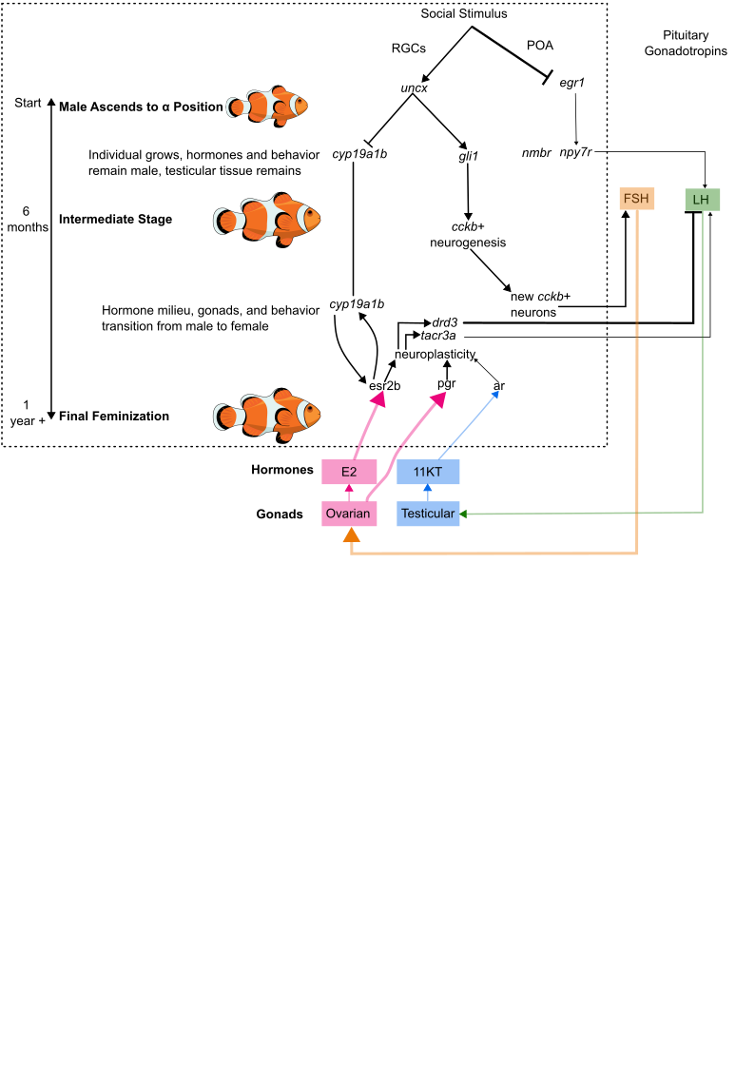
Fig.7 Schematic outlining our model of the changes that occur during protandours sex change in A. ocellaris. Thicker lines indicate increased output, thinner lines indicate decreased output. Arrows indicate stimulation and blunt ends indicate inhibition.
Notes:
Add caveat that lh and fsh were not observed, dotted circle around the same cells

Slide 14
A
16
B
d
ab
c
a
c
ab
bcd
abc
d
ab
c
a
cd
ab
bcd
abc
12
8
Mass (g)
Length (cm)
1.44x
8
3.12x
6
1.31x
1.28x
1.28x
4
2.33x
2.19x
2.52x
F
M
I
IP
LI
LIP
NF
NM
4
F
M
I
IP
LI
LIP
NF
NM
C
c
a
bc
ab
d
abc
D
180%
130%
b
a
ab
ab
c
ab
150%
120%
Change Mass %
Change Length %
120%
110%
90%
I
IP
LI
LIP
NF
NM
100%
E
F
I
IP
LI
LIP
NF
NM
c
b
a
cd
d
cd
7.5
bc
a
c
ab
a
abc
6
7.0
4
Log10 Ovarian Volume (px)
Log10 Testicular Volume (px)
6.5
2
0
6.0
I
IP
LI
LIP
M
NM
I
IP
LI
LIP
M
NM
Phase
Supplementary Fig.1.
Body mass by phase.
(B) Body length by phase. Plots are subdivided such that the dominant and subordinate individuals from each pair appear together reflected by shape and color.
(C) Change in body mass by phase.
(D) Change in length by phase.
(E) Log10 testicular volume estimate by phase.
(F) Log10 ovarian volume estimate by phase.
Crossbar indicates mean, error bars indicate standard error of the mean (SEM). Letters indicate significance: groups that do not share a letter are significantly different. In A, B Arrows indicate fold-difference between the two groups.
Notes:
Supplementary physiology

Slide 15
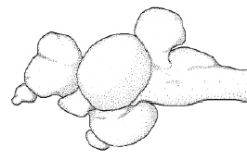
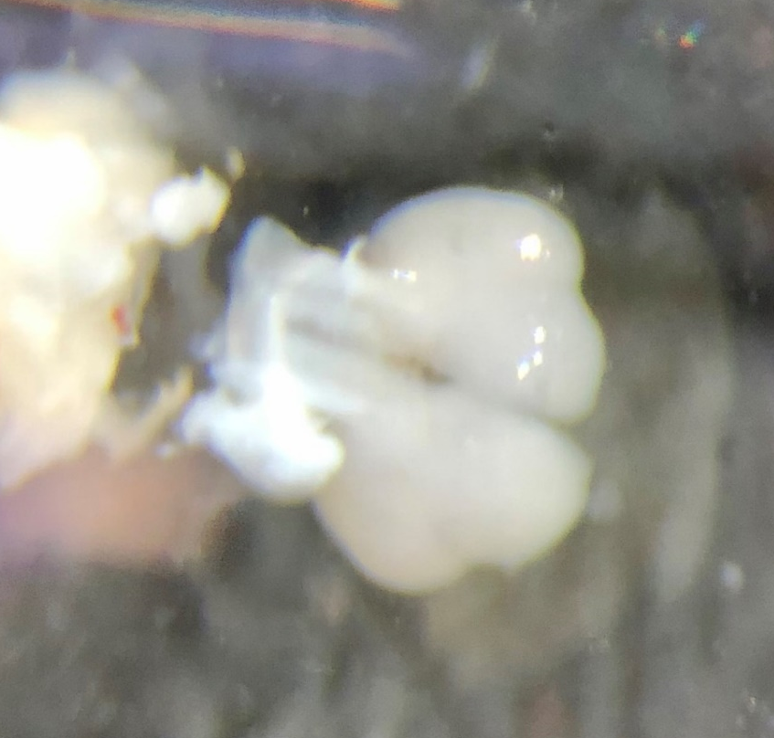
A
3
2
4
1
POA
Blue dotted lines represent cuts made
B
POA

Slide 16
Supplementary Fig.2.
Side view of anemonefish brain with dissections indicated by dashes blue lines. The number indicates the order of cuts.
(B) Top down vies of anemonefish brain with dissections indicated by dashed blue lines. In A and B, the POA is highlighted with a red circle

Slide 17
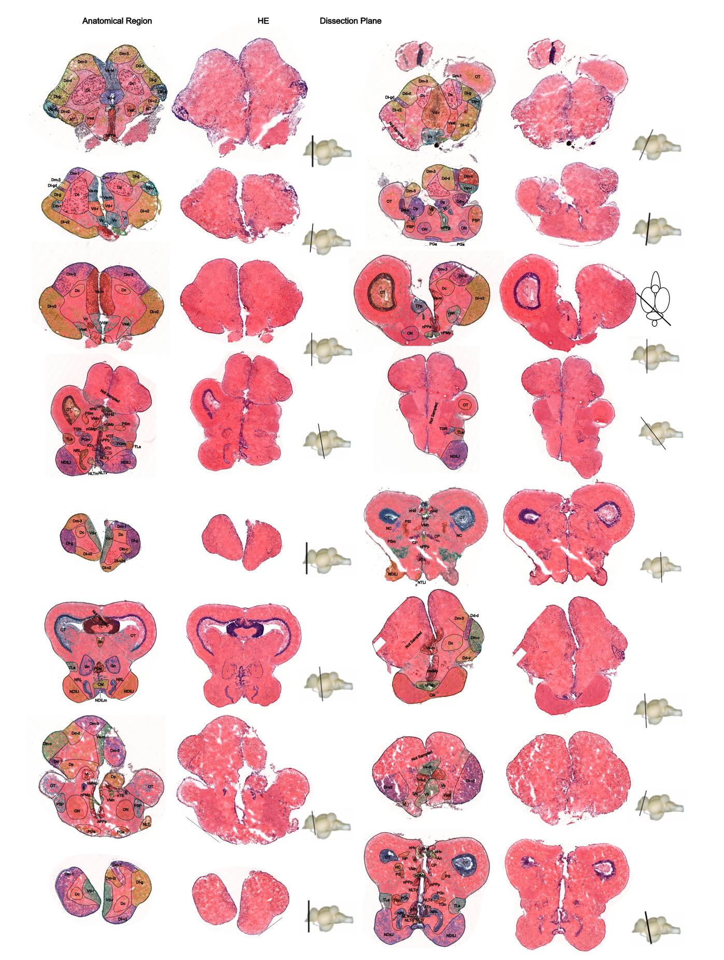
Notes:
Work in progress, I will make better

Slide 18
Supplementary Fig.3. Drawings of each section sequenced with Visium HD with neuroanatomical regions labeled. The middle column displays the unlabeled hematoxylin and eosin stain and the right column shows a small brain from the side with a black line indicating the sectioning plane for the given section.

Slide 19
Parker 2024 Parent Clusters
Parent Cluster
Scaled Proportion
of Region
Supplementary Fig.4 Heatmap of Parker 2024 parent clusters mapped onto the Visium HD data in this work. The color in the heatmap indicates the scaled proportion of cells from each parent cluster composing each neuroanatomical region.

Slide 20
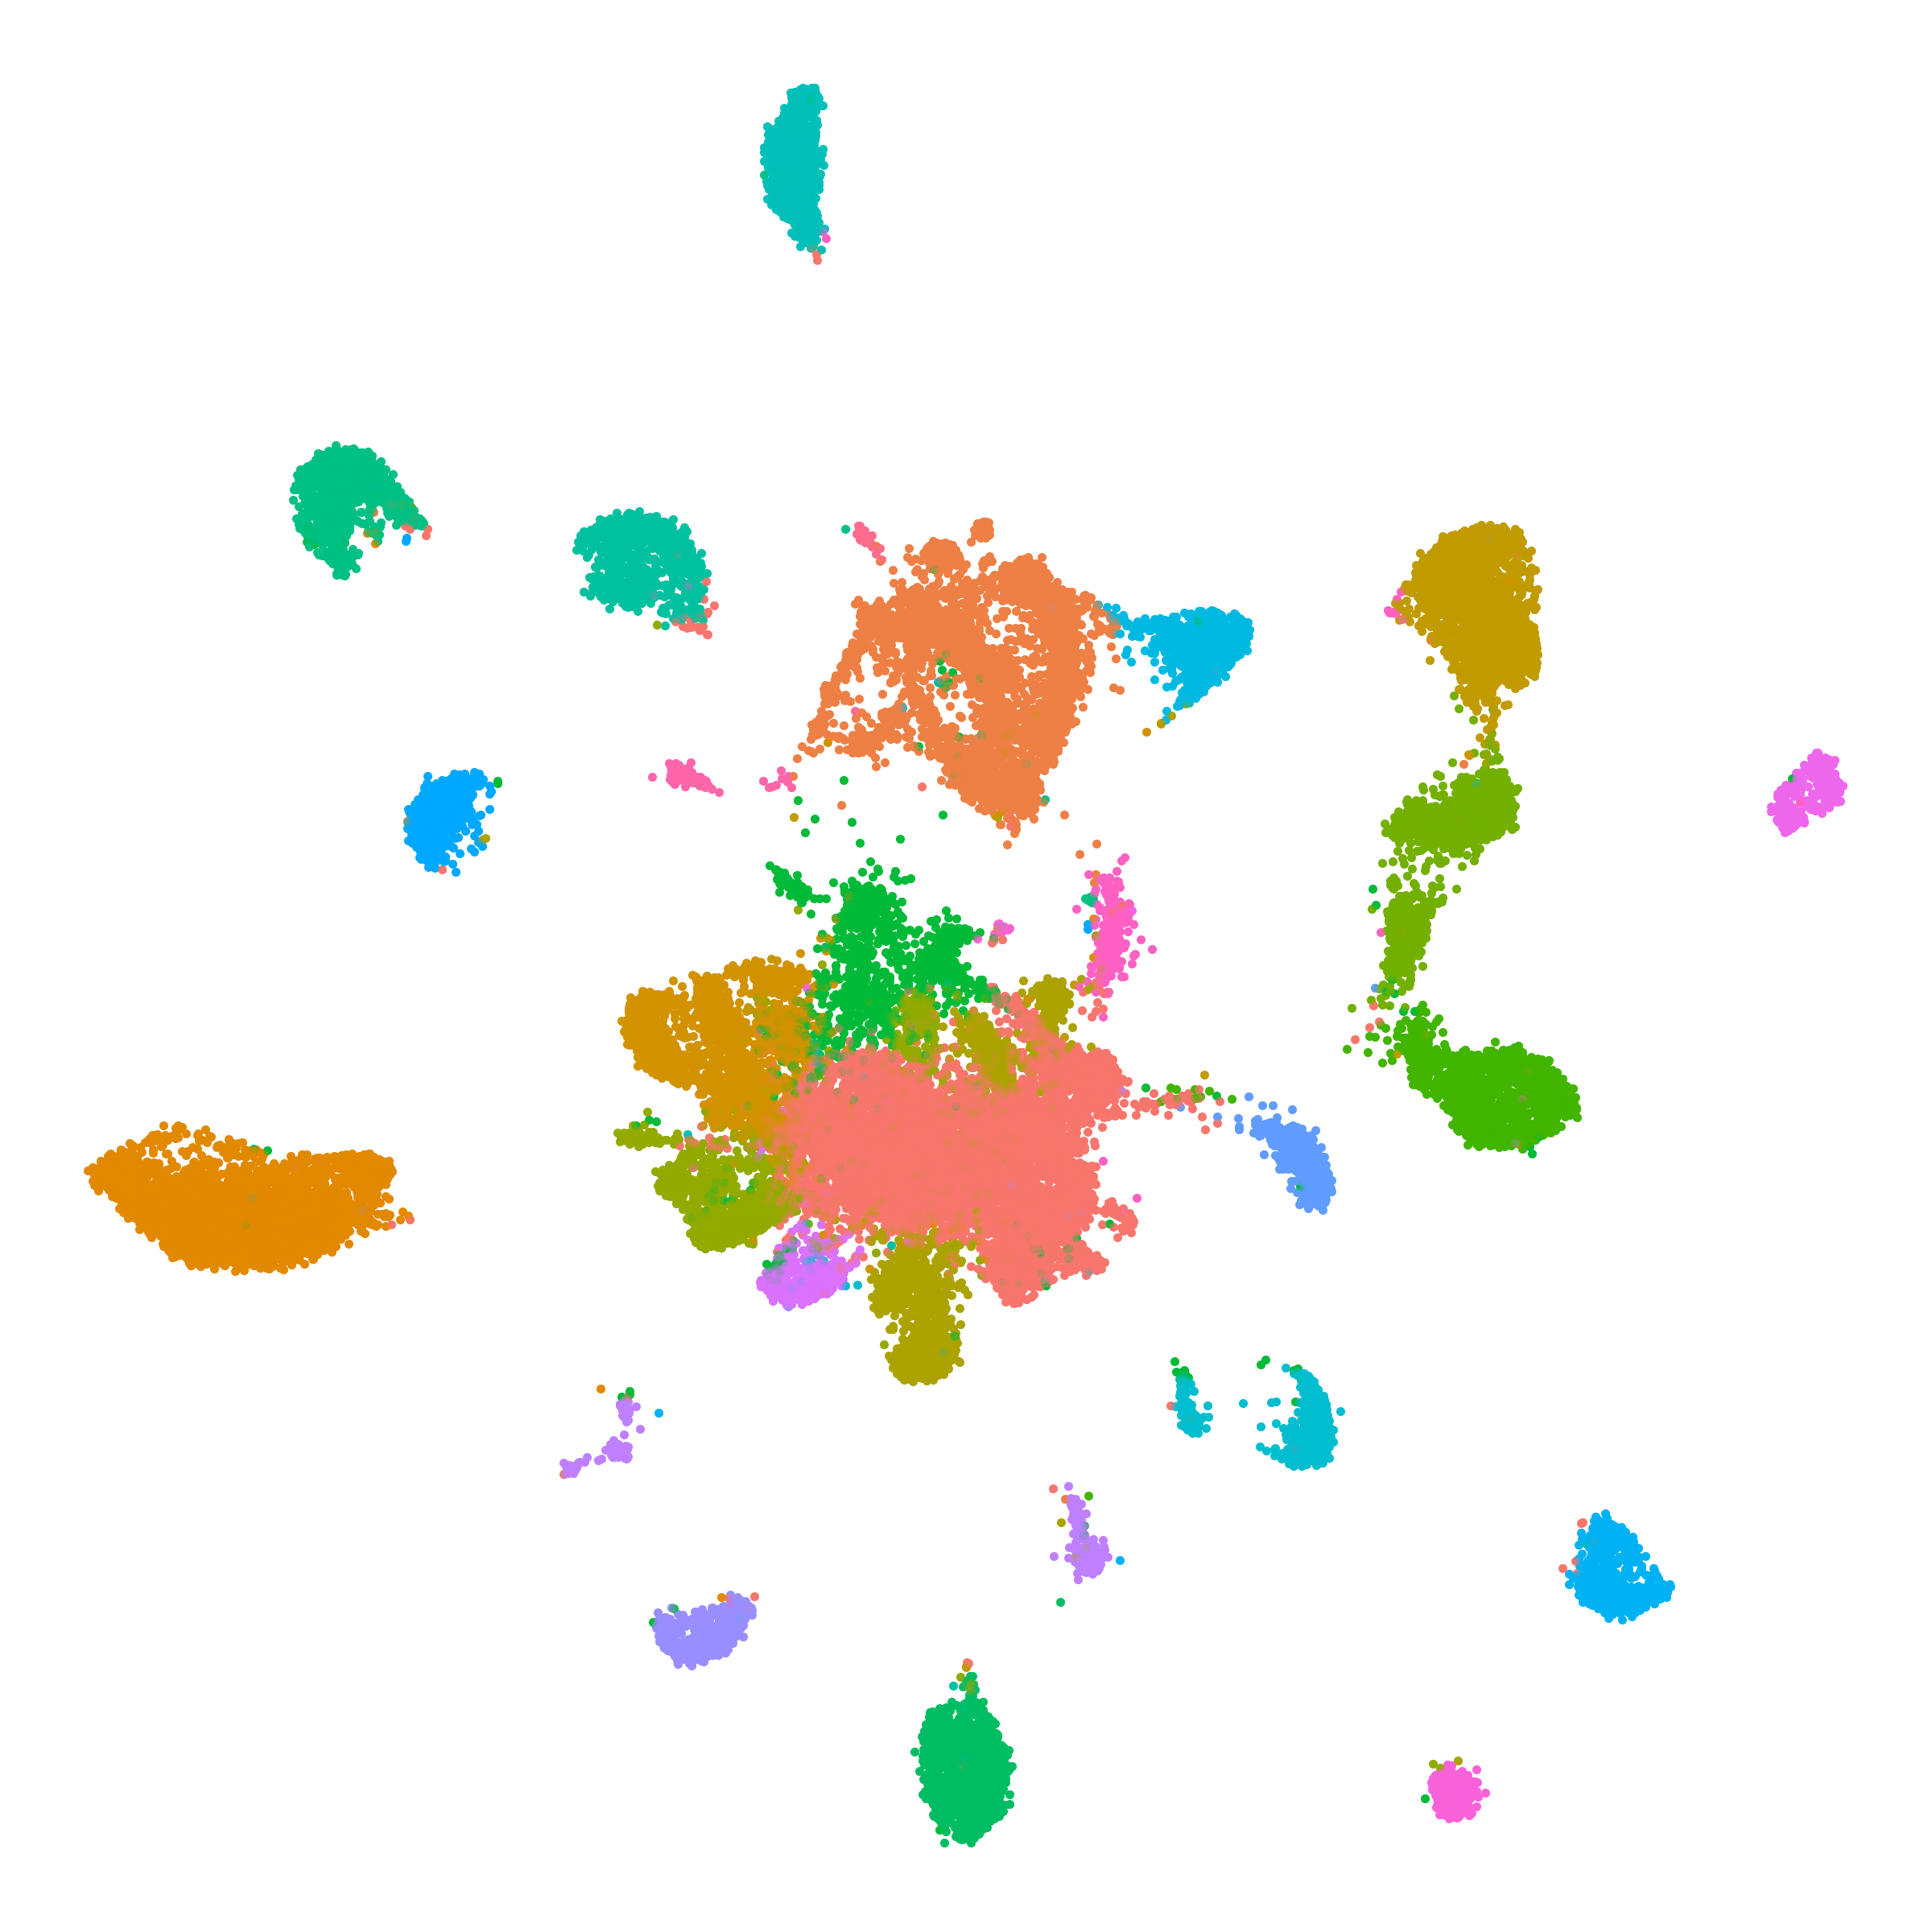
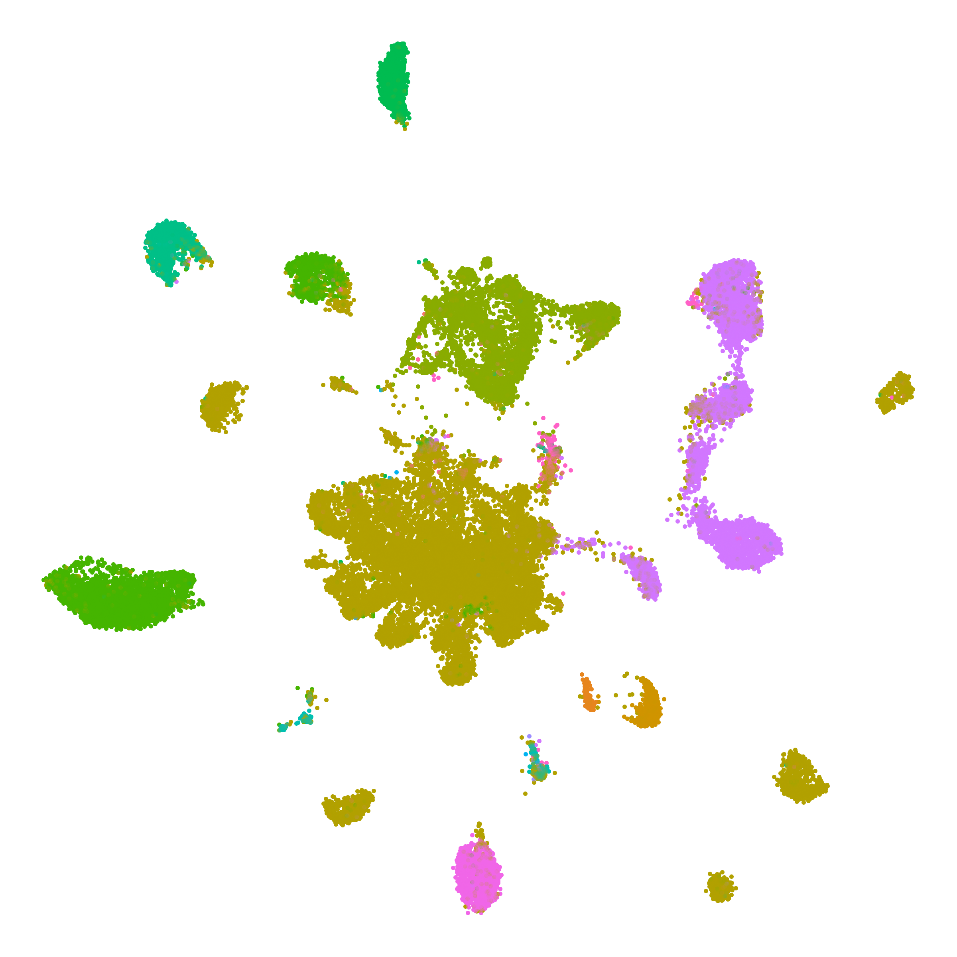
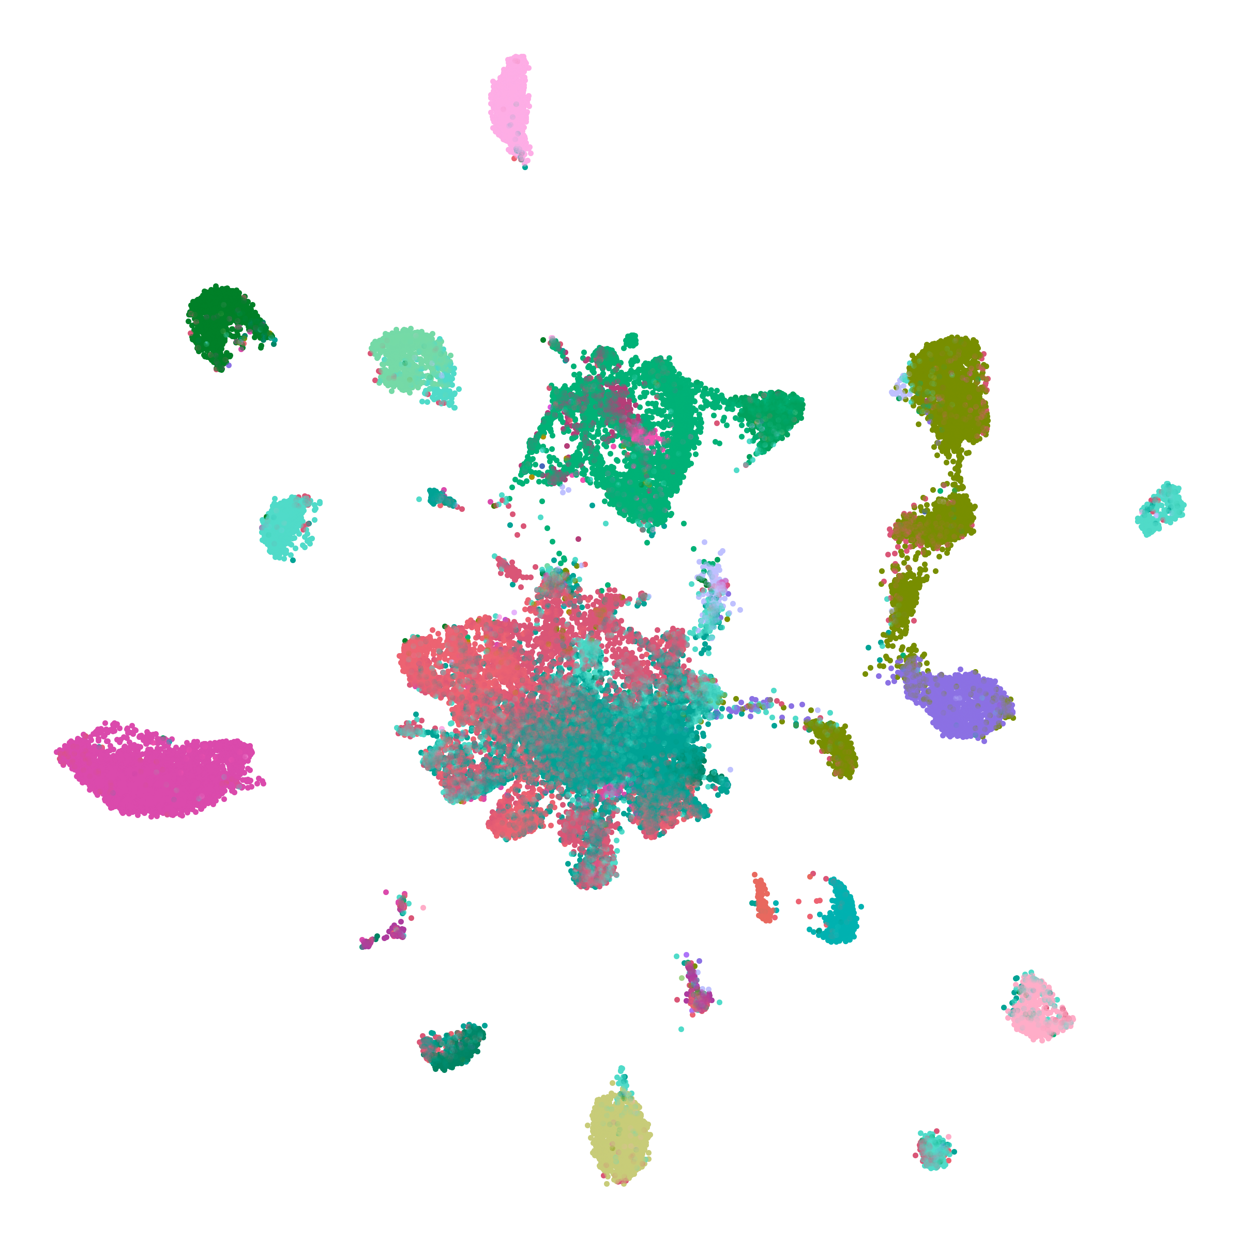
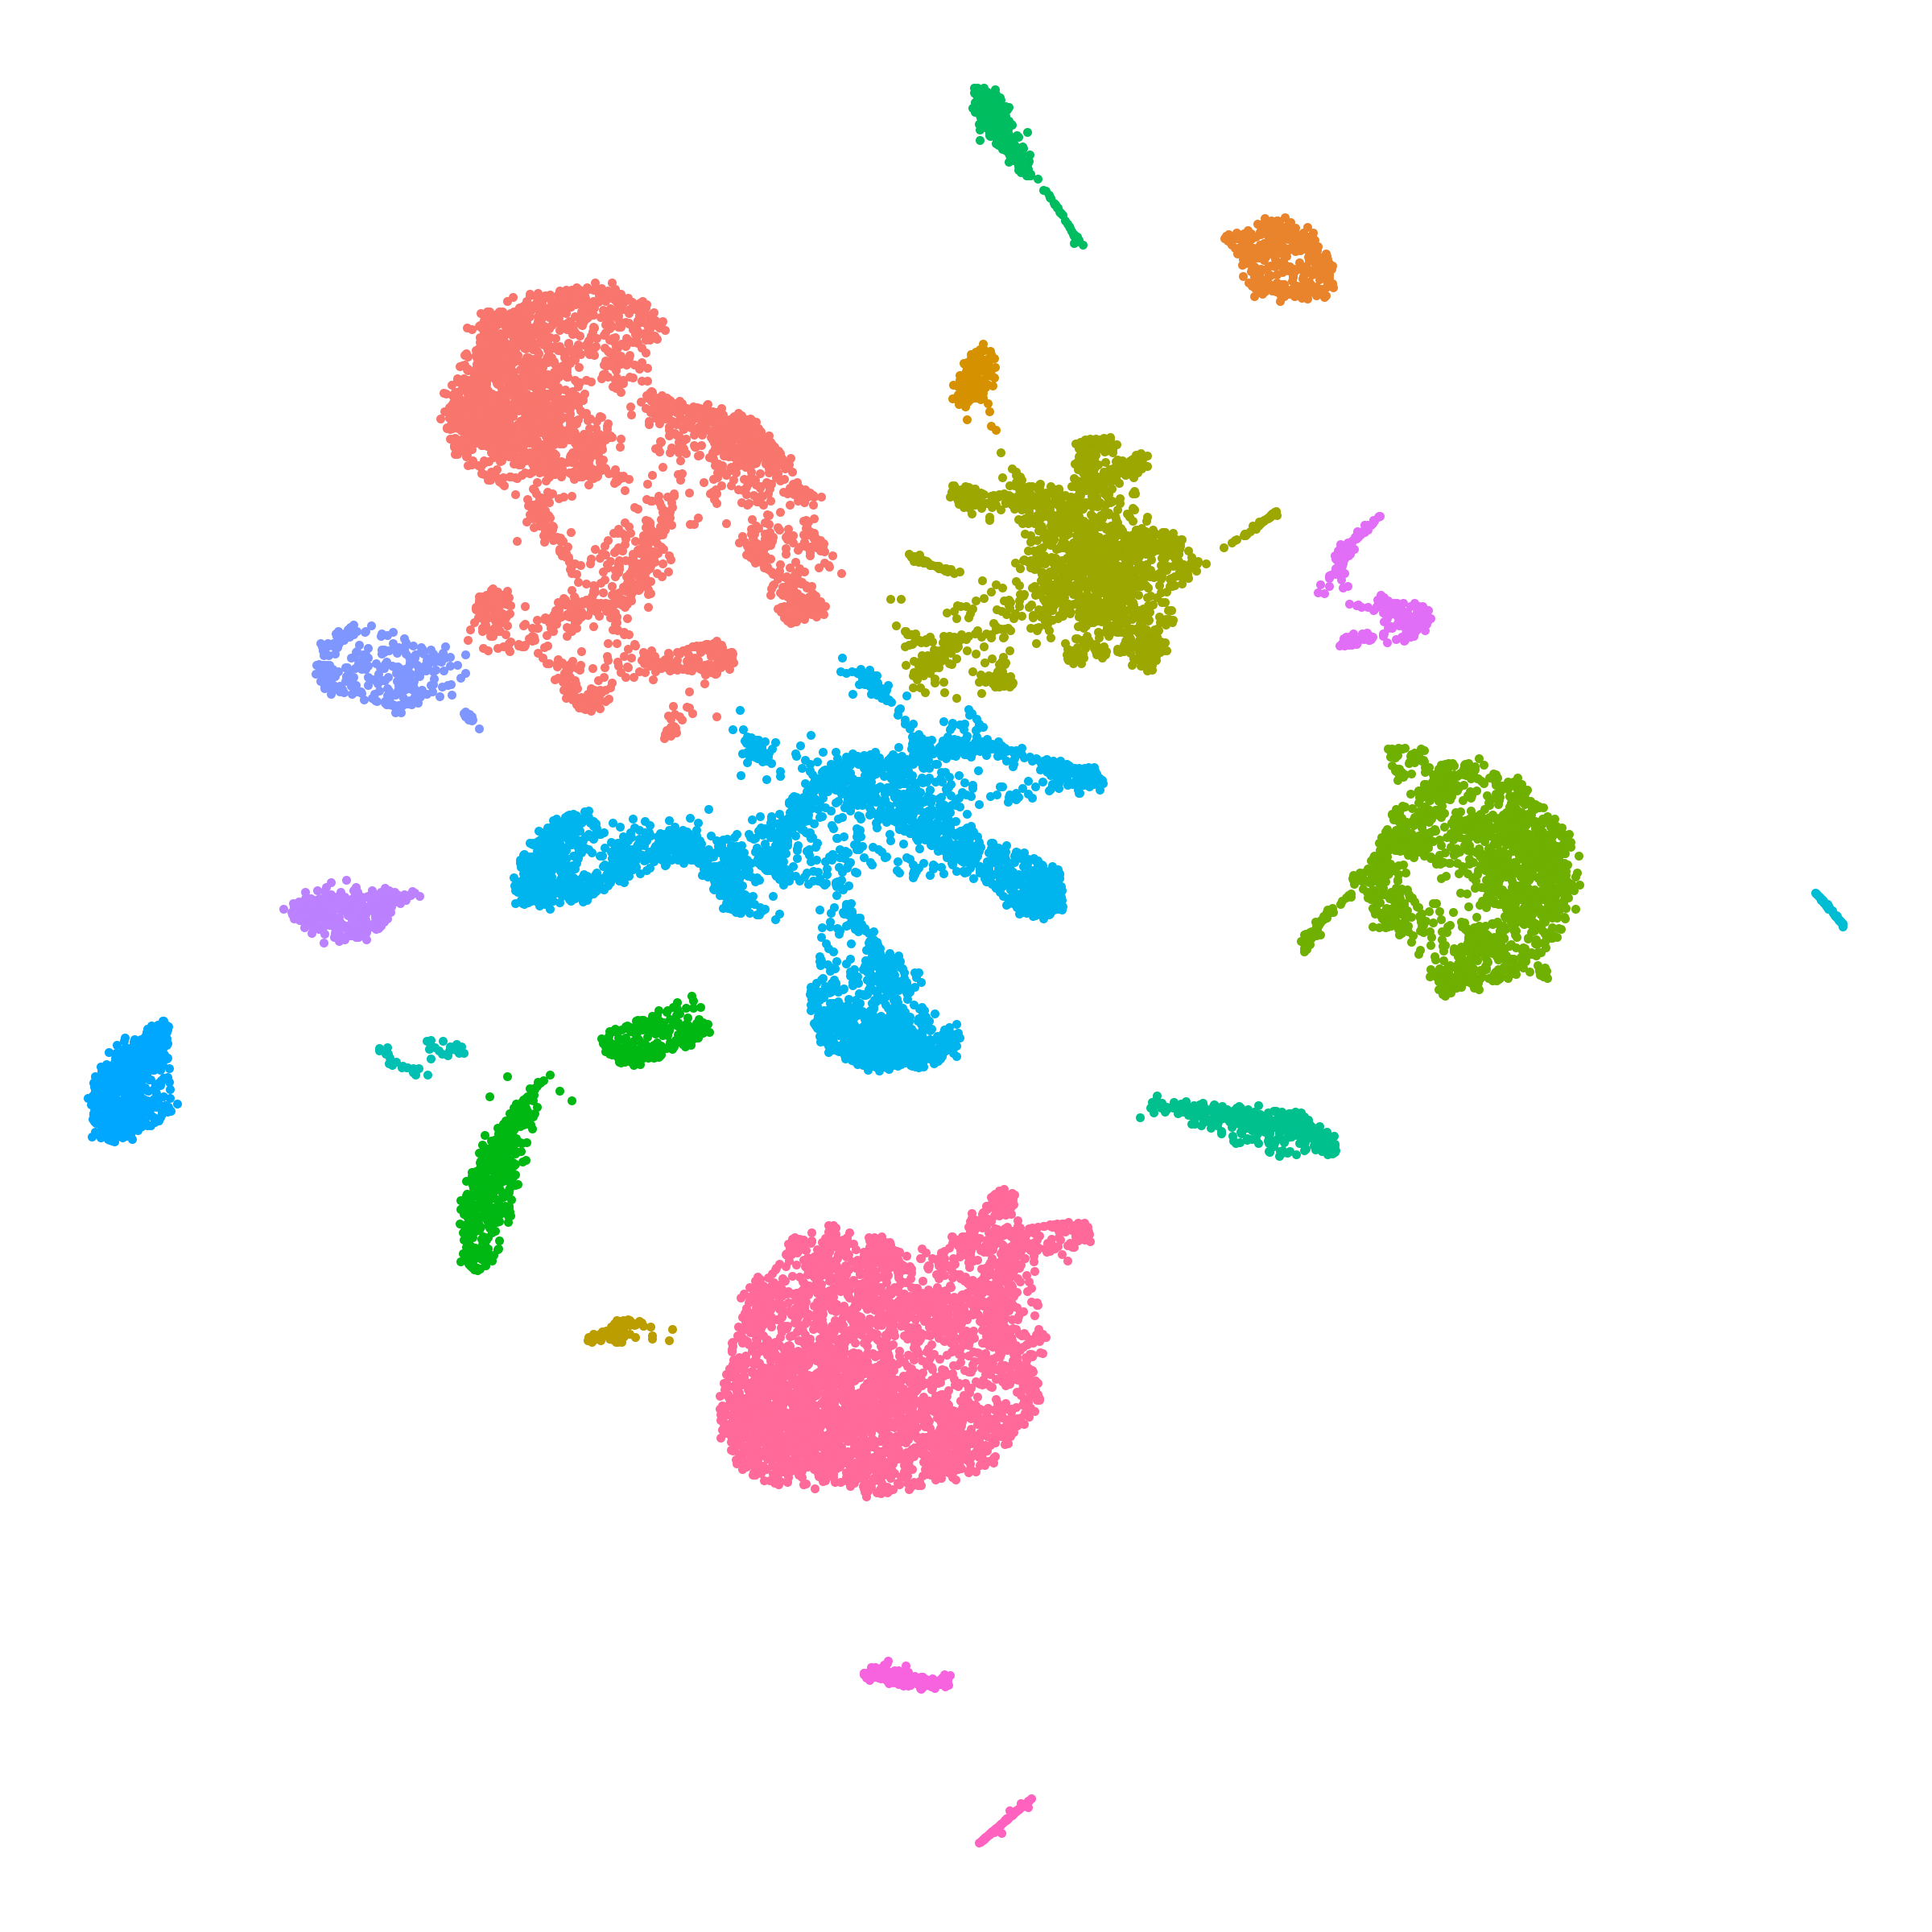
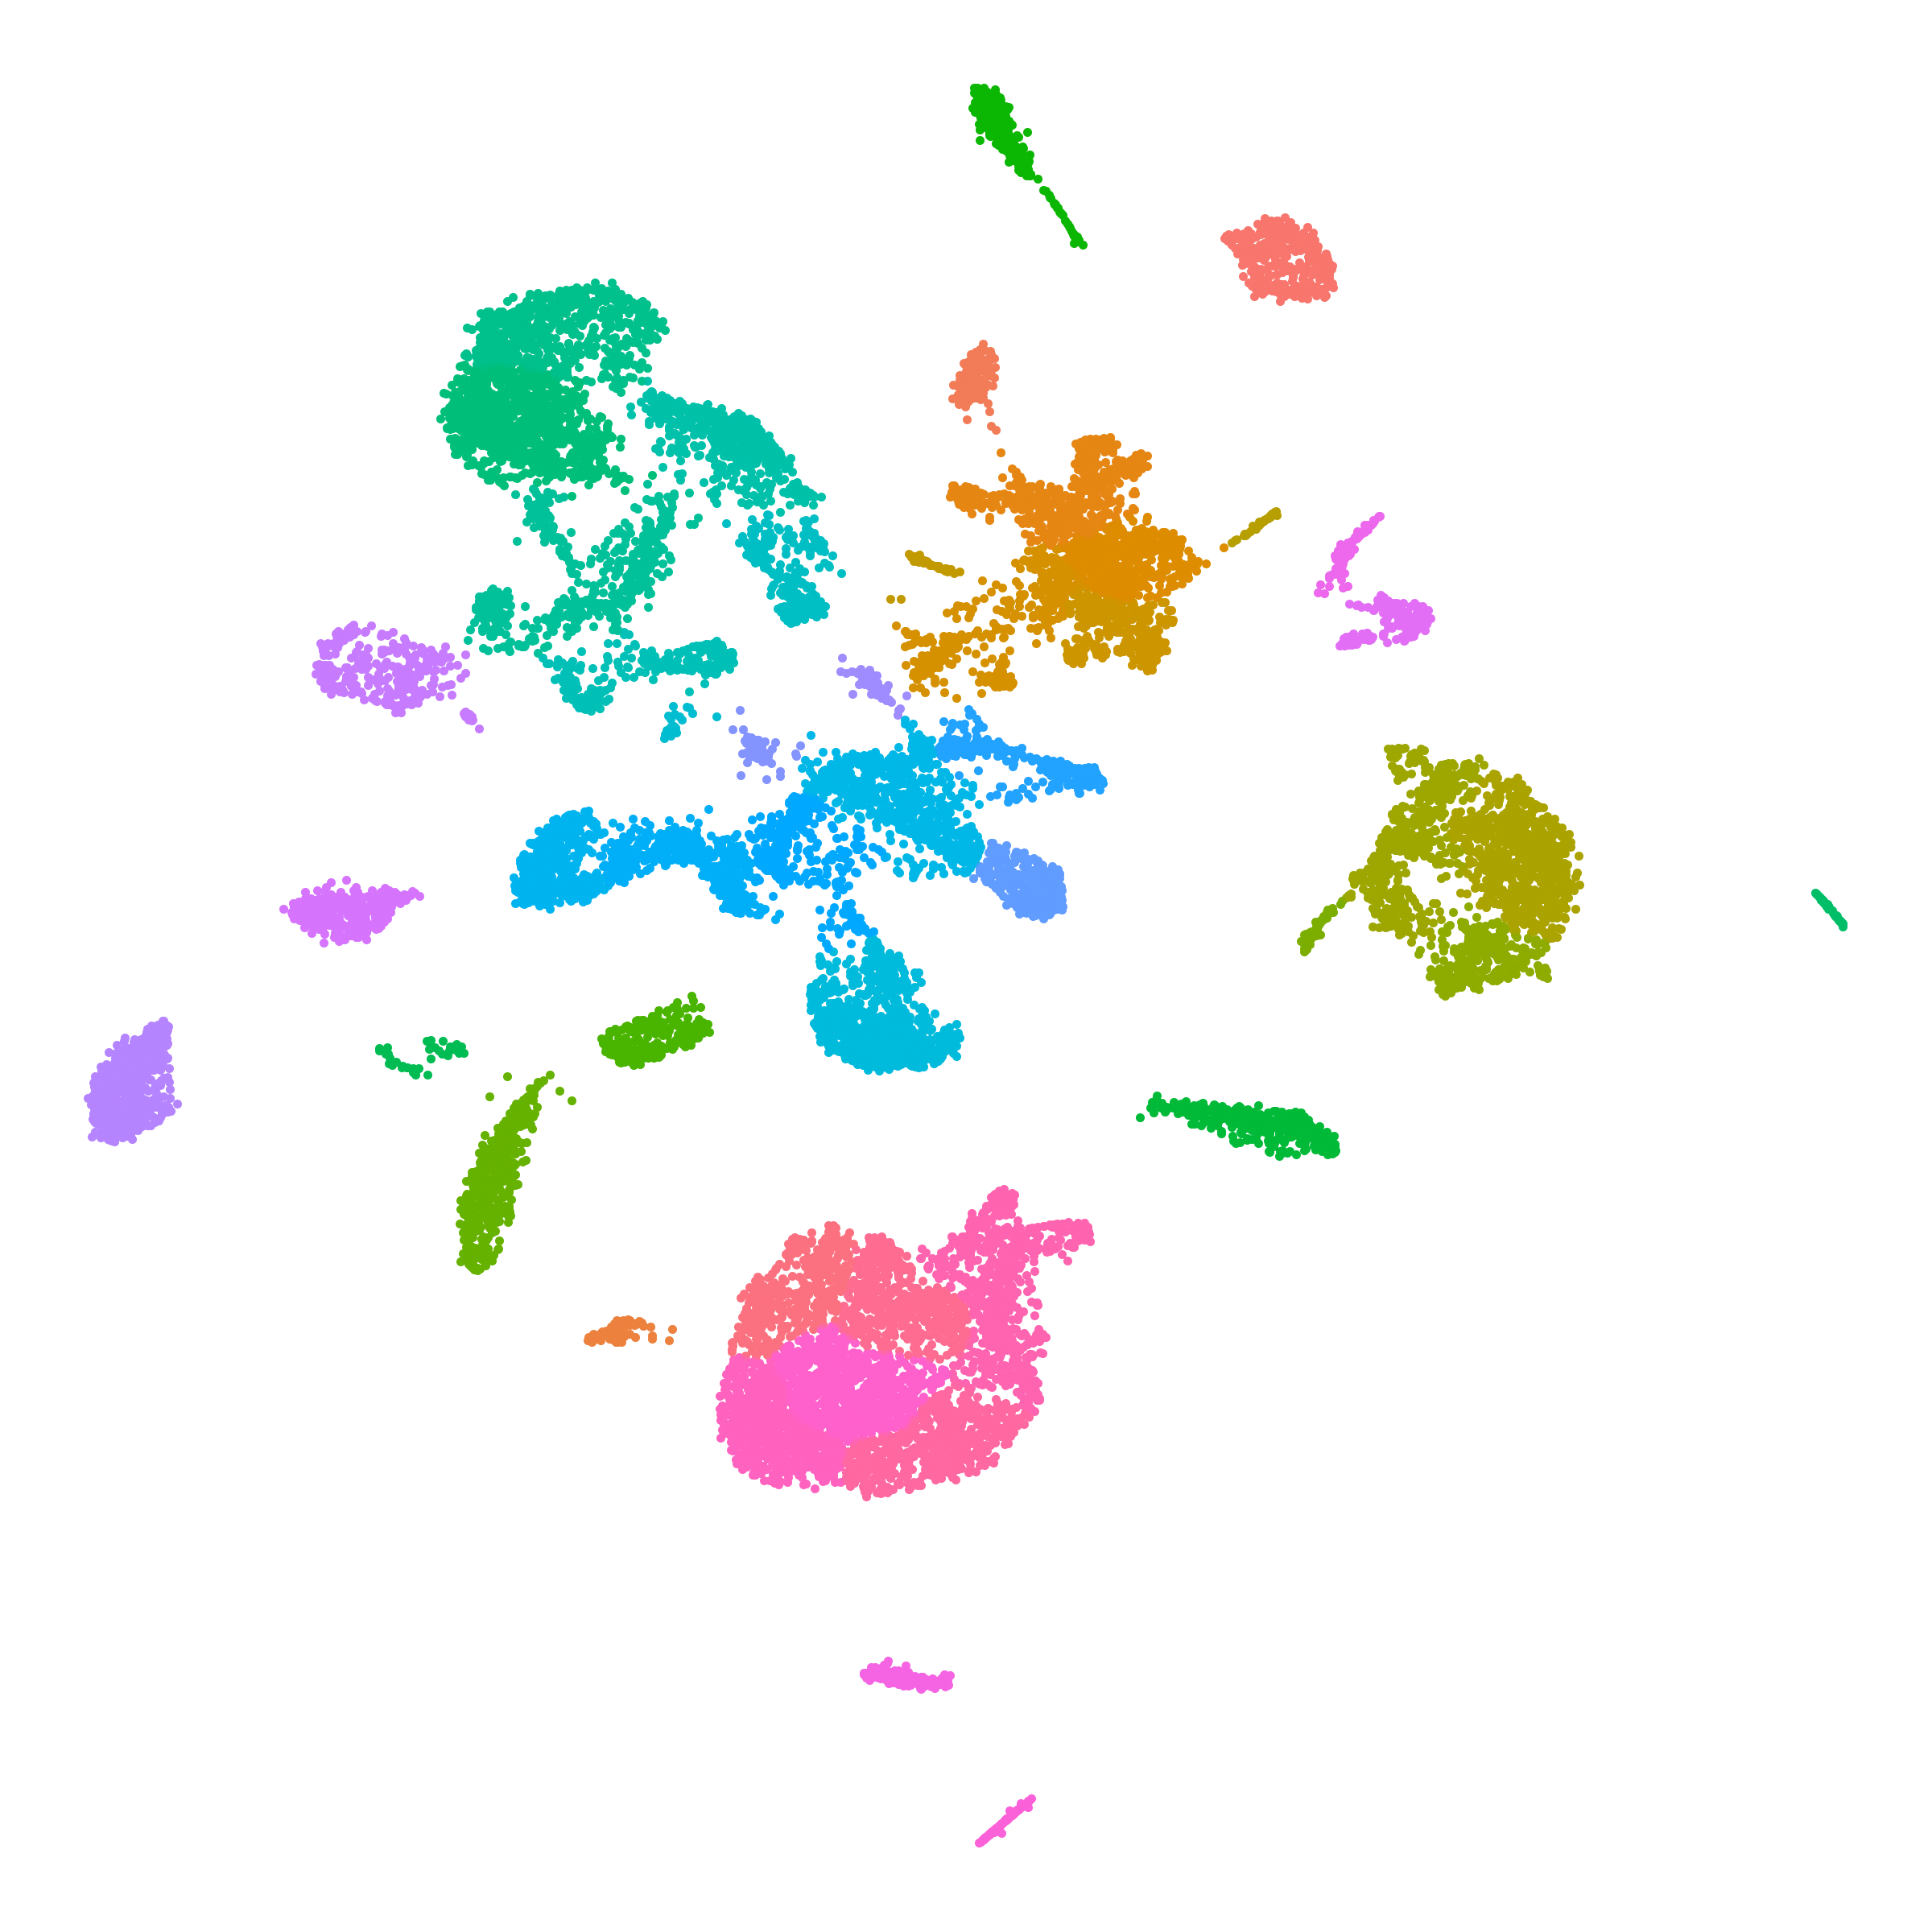
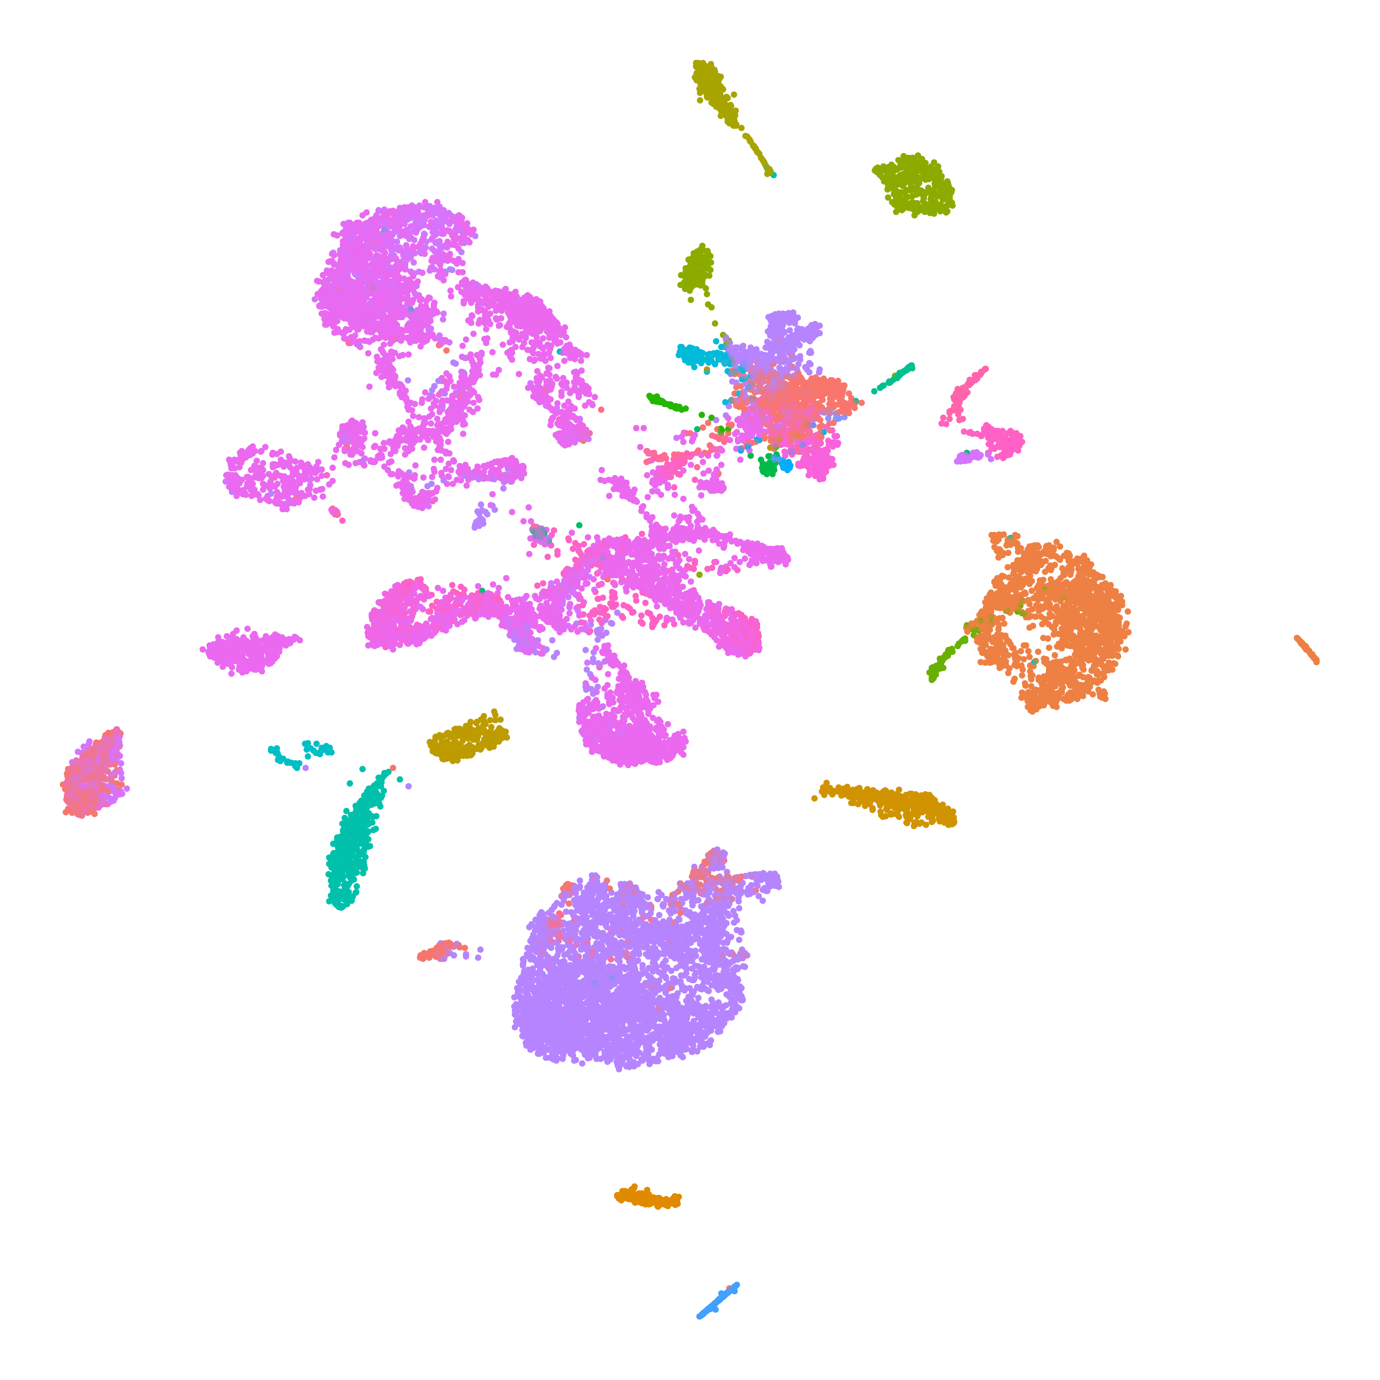
A
This work
Parker 2024 parent clusters →
this work
Parker 2024 child clusters →
this work
16
Parent Cluster
16
13
1
10
Child Cluster
11
26
17
11
17
15b
10
19
12
13
1f
11
1f
14c
1
15
4
14
14a
14d
13a
1g
14
14b
13b
2a
25
22
15
6a
13c
2b
17
6
16
2g
1g
2e
13d
2e
7
8
9c
13e
2g
24
19
8
13f
2h
9
17
9f
14a
4
3
8
13
18
13c
13d
2h
6b
14b
5
0
18
13a
13b
9a
14c
6a
2
6
15
19
15a
2a
14d
6b
21
2
4
2b
15a
7
5
15b
8
10
4
10
16
9a
14
5
11
11
17
9c
20
18
5
5
18
9f
UMAP_2
19
16
6
13f
18
13e
10
23
7
7
7
UMAP_1
8
9
Parker 2024 Parent Clusters
Parker 2024 Child Clusters
This work → Parker 2024
B
16
16
13
14
Multiome Cluster
11
10
1b
11
10
4
25
0
20
1a
1d
21
19
1
21
1
13a
13f
0
8
10
22
13
13e
13b
6b
16
6
6
1c
1f
13d
6a
17
22
11
23
4
1e
13c
5
9
23
4
1g
2i
18
12
24
2h
2f
7
2
2d
2b
14b
1
13
25
5
14
19
5
2c
2e
2g
14d
14a
19
12
15
14
3
3
18
18
15b
2a
14c
20
11
15
4
15
17
3
17
2
16
5
15a
9c
3
17
6
9e
12
9f
18
7
9
12
9a
19
8
UMAP_2
9b
9d
2
9
7
7
10
UMAP_1
8
8
24
C
This work → Parker 2024 Child Clusters
Proportion Child Cluster
Labeled Multiome Cluster
Parker 2024 Child Cluster
Multiome Cluster

Slide 21
Supplementary Fig.5 Results of label transfer from Parker 2024 dataset.
Projection of Parker 2024 parent and child clusters onto the current work.
(B) Clusters from the current work projected onto the Parker 2024 object.
(C) Heatmap showing the proportion of each child cluster in the Parker 2024 labeled with the clusters from this work in a multiome to Parker 2024 child cluster mapping.

Slide 22
A
Cells
0_Spall_Mixed
1_RGC
2_OL
3_Spall_GABA
4_TGN_GABA
7_Pall_Glut
***
25%
p = 0.907
***
12.5%
**
**
p = 0.799
***
30%
p = 0.779
***
20%
**
***
20%
***
***
10.0%
p = 0.107
p = 0.211
10%
**
9%
*
***
20%
15%
15%
7.5%
6%
10%
10%
10%
5.0%
5%
3%
5%
5%
2.5%
0%
0%
0%
0%
0%
0.0%
M
I
LI
NF
F
M
I
LI
NF
M
I
LI
F
NF
F
M
I
LI
NF
M
I
LI
F
NF
F
M
I
LI
NF
% of Cells
F
9_Mixed
11_MG
12_Glut
19_Di_GABA
22_Di_Glut
24_Vs-m_Mixed
10.0%
***
**
6%
p = 0.094
4%
p = 0.848
**
**
7.5%
p = 0.158
**
6%
*
p = 0.347
4%
**
p = 0.235
3%
*
**
2%
p = 0.634
**
2%
p = 0.389
***
5.0%
4%
2%
2%
1%
1%
2.5%
2%
1%
0.0%
M
0%
0%
0%
0%
0%
I
LI
NF
F
M
I
LI
NF
F
M
I
LI
NF
F
M
I
LI
NF
F
M
I
LI
NF
F
M
I
LI
NF
F
Phase
Neurons
B
0_Spall_Mixed
4_TGN_GABA
7_Pall_Glut
9_Mixed
14_Vsst_GABA
30%
*
*
p = 0.27
***
10.0%
***
6%
*
*
***
10%
**
9%
p = 0.096
***
7.5%
p = 0.439
**
5%
**
p = 0.327
20%
6%
4%
5%
5.0%
3%
10%
3%
2.5%
2%
0%
0%
0.0%
1%
0%
M
I
LI
0%
NF
F
M
I
LI
NF
F
M
I
LI
NF
F
M
I
LI
NF
M
I
LI
F
NF
17_Glut
F
18_Glut
19_Di_GABA
22_Di_Glut
24_Vs-m_Mixed
% of Neurons
**
*
**
5%
**
p = 0.272
5%
*
4%
p = 0.515
4%
p = 0.086
4%
p = 0.715
3%
p = 0.053
**
2%
p = 0.378
**
2%
p = 0.229
***
3%
3%
2%
2%
2%
1%
1%
1%
1%
1%
0%
M
I
LI
0%
0%
0%
0%
NF
F
M
I
LI
NF
F
M
I
LI
NF
F
M
I
LI
NF
F
M
I
LI
NF
Phase
F
Supplementary Fig.6.
Percent of all cells belonging to each multiome cluster.
(B) Precent of all neurons belonging to each multiome cluster.
Only significant results are shown. Points indicate the mean for each individual. Asterisks: “*”: p < 0.05, “**”: p < 0.01, “***”: p < 0.001.

Slide 23
igf2bp3
A
pax3b
1_RGC DARs — Mean Z-Score by Phase
spice1
M
I
F
tdrd9
†
gls1-like
2
gabrb1
1
Z-Score
Type
Label
pik3c2b
0
†
Late Down
Transcription Factor
Late Up
-1
fam172a
Progressively Down
Progressively Up
B
C
LOC129348612
1_NP
p.adjust
-2
neuron differentiation
1.00
c
a
b
b
axon guidance
0.0005
plekhm3
0.75
Wnt signaling pathway
0.0010
Negative regulation of forebrain development
0.0015
CytoTRACE
canonical Wnt signaling
0.50
sorbs2a
central nervous system development
Count
0.25
cell fate commitment pathway
canonical Wnt signaling pathway
5
1_NP
frizzled binding
10
1_shha
1_NSC
1_gfap
negative regulation of axon extension involved in axon guidance
Subcluster
15
0.02
0.04
0.06
0.08
0.10
GeneRatio

Slide 24
Supplementary Fig.7.
DARs in 1_RGC. Cells are colored by z-score of the mean accessibility or expression for each phase. The top bar indicates the classification for how each gene or region changes sex, and the symbols below the matrix indicate what kind of gene is differentially accessible or differentially expressed.
(B) CytoTRACE score by 1_RGC subcluster. Letters above indicate significance, if two subclusters share a letter they are not significantly different.
(C) Gene ontology analysis of marker genes for 1_NP.
Color indicates false discovery rate adjusted p value, point size indicates the number of genes annotated with that term, and “GeneRatio” indicates the proportion of genes annotated with that GO term divided by all annotated genes in our list.

Slide 25
A
1_NSC
p.adjust
D
Average Expression
dendrite
1e-07
axon
-1.0
-0.5
postsynaptic membrane
2e-07
0.0
0.5
1.0
postsynaptic density
Percent Expressed
postsynaptic density membrane
3e-07
0
20
40
60
80
dendritic spine
Count
lmx1.2-like
modulation of chemical synaptic transmission
50
proton transmembrane transport
100
synaptic membrane adhesion
pik3r5-like
Ionotropic glutamate receptor signaling pathway
150
0.02
0.04
0.06
LOC118470146
GeneRatio
p.adjust
B
1_gfap
six6a
collagen-containing
0.02
extracellular matrix
LOC129350005
0.03
axon guidance
ror1
Count
dopaminergic neuron
4
tmem266
differentiation
6
somite development
8
zkscan8-like
10
0.025
0.050
0.075
0.100
12
angpt1
GeneRatio
gfap
C
1_shh
p.adjust
axon guidance
0.005
shha
0.010
negative chemotaxis
0.015
cyp19a1b
anatomical structure
Count
0.020
formation involved in
4
morphogenesis
6
gja1b
0.04
0.06
0.08
0.10
0.12
0.14
8
GeneRatio
10
1_NSC
1_NP
1_shha
1_gfap
1_RGC Subcluster

Slide 26
Supplementary Fig.8. Gene ontology (GO) analysis for the marker genes of
1_NSC,
(B) 1_gfap, and
(C) 1_shha.
In A-C, color indicates false discovery rate adjusted p value, point size indicates the number of genes annotated with that term, and “GeneRatio” indicates the proportion of genes annotated with that GO term divided by all annotated genes in our list. (D) Canonical and data-driven marker genes for each 1_RGC subcluster

Slide 27
6_POA_Mixed DEGs:GO
p.adjust
GPCR signaling pathway
0.01
GPCR receptor activity
0.02
positive regulation of transcription by RNA pol III
0.03
protein tyrosine phosphatase activity
Count
learning or memory
2
non-membrane spanning protein tyrosine phosphatase activity
3
protein tyrosine phosphatase activity, metal-dependent
4
perineuronal net
5
estrogen response element binding
6
peptidyl-tyrosine dephosphorylation
7
0 .05
0.10
0.15
GeneRatio
Supplementary Fig.9. GO analysis of all of the DEGs in 6_POA_Mixed. Ccolor indicates false discovery rate adjusted p value, point size indicates the number of genes annotated with that term, and “GeneRatio” indicates the proportion of genes annotated with that GO term divided by all annotated genes in our list.

Slide 28
A
npy7r
0.20
***
**
**
p = 0.101
7.5%
p = 0.158
p = 0.114
0.15
Percent npy7r+
Expression
5.0%
0.10
0.05
2.5%
0.00
0.0%
nmbr
B
1.0
***
50%
**
**
p = 0.935
40%
p = 0.487
*
0.8
30%
Expression
Percent nmbr+
0.6
20%
0.4
10%
0.2
0%
C
gnrh1
Main effect p > 0.05
0.3
Main effect p > 0.05
10%
0.2
Percent gnrh1+
Expression
5%
0.1
0.0
0%
pgr
D
*
**
0.4
*
***
20%
p = 0.410
***
0.9
Main effect p > 0.05
Expression
Percent pgr+
CytoTRACE
0.2
10%
0.6
0.3
0.0
0%
E
ar-like
**
***
0.4
p = 0.620
***
p = 0.556
**
0.9
Main effect p > 0.05
0.3
20%
Expression
Percent ar_like+
CytoTRACE
0.2
0.6
0.1
10%
0.3
M
I
LI
NF
F
0%
M
I
LI
NF
F
M
I
LI
NF
F
Phase

Slide 29
Supplementary Fig.10. Expression (left) and percent of 6_POA_Mixed (right) expressing
npy7r,
(B) nmbr,
(C) gnrh1. Expression (left) and percent of 6_POA_Mixed (middle), and CytoTRACE score (right) of cells expressing
(D) pgr,
(E), ar-like.
Points indicate the mean for each individual. Asterisks: “*”: p < 0.05, “**”: p < 0.01, “***”: p < 0.001.

Slide 30
A
B
1_RGC GRN
6_POA_Mixed GRN
Classification
Early Down
NA
Transient Down
Late Down
Transient Up
Late Up
Type
Connection
TF
Positive
Negative
Target gene
Accessibility Coupled
Focal gene
TF-associated/open
Thickness = |r|

Slide 31
Fig. S11. Candidate transcriptional regulatory networks in radial glia and preoptic area neurons during sex change. (A) Accessibility-coupled gene regulatory network (GRN) in radial glial cells (1_RGC). (B) Combined network of accessibility-coupled and TF-associated regulatory relationships in preoptic area neurons (6_POA_Mixed), highlighting candidate regulators of genes involved in neuroendocrine signaling and neuronal plasticity. Rectangles represent transcription factors (TFs), ovals represent target genes, and thick black outlines identify focal genes. Node colors indicate the direction and temporal pattern of differential expression across males, intermediates, and females: early down (yellow), transient down (tan), transient up (pink), late down (purple), and late up (blue). Gray indicates genes without significant differential expression (NA). Directed arrows indicate candidate TF–target relationships, with blue and red representing positive and negative expression correlations, respectively. Solid arrows indicate accessibility-coupled relationships supported by a TF-binding motif, significant correlation between local chromatin accessibility and target-gene expression, and correlated TF–target expression. Dashed arrows indicate TF-associated relationships in which the motif occurs in accessible chromatin but accessibility is not significantly correlated with target-gene expression. Candidate TFs were detected in ≥50% of individuals, and TF–target expression correlations met |r| ≥ 0.40 and P ≤ 0.10. Arrow thickness is proportional to the absolute correlation coefficient (|r|). Supplementary Fig. 11. Candidate transcriptional regulatory networks in radial glia and preoptic area neurons during sex change. (A) Accessibility-coupled gene regulatory network (GRN) in radial glial cells (1_RGC). (B) Combined network of accessibility-coupled and TF-associated regulatory relationships in preoptic area neurons (6_POA_Mixed), highlighting candidate regulators of genes involved in neuroendocrine signaling and neuronal plasticity. Rectangles represent transcription factors (TFs), ovals represent target genes, and thick black outlines identify focal genes. Node colors indicate the direction and temporal pattern of differential expression across males, intermediates, and females: early down (yellow), transient down (tan), transient up (pink), late down (purple), and late up (blue). Gray indicates genes without significant differential expression (NA). Directed arrows indicate candidate TF–target relationships, with blue and red representing positive and negative expression correlations, respectively. Solid arrows indicate accessibility-coupled relationships supported by a TF-binding motif, significant correlation between local chromatin accessibility and target-gene expression, and correlated TF–target expression. Dashed arrows indicate TF-associated relationships in which the motif occurs in accessible chromatin but accessibility is not significantly correlated with target-gene expression. Candidate TFs were detected in ≥50% of individuals, and TF–target expression correlations met |r| ≥ 0.40 and P ≤ 0.10. Arrow thickness is proportional to the absolute correlation coefficient (|r|).

